Slide 1
Mitchell and Merritt’s Algorithm for single resource model
Works on the single resource model Belongs to the class of edge-chasing algorithms where probes are sent in opposite direction of the edges of WFG.
Each node has two labels- Private and Public where initially both has same values
Private is unique but might change
Has four nondeteministic state transitions
- Block, Transmit, Detect, Activate
Notes:
https://groups.csail.mit.edu/tds/papers/Merritt/podc84.pdf
No phantom deadlocks as long as process’ dont fail.

Slide 2
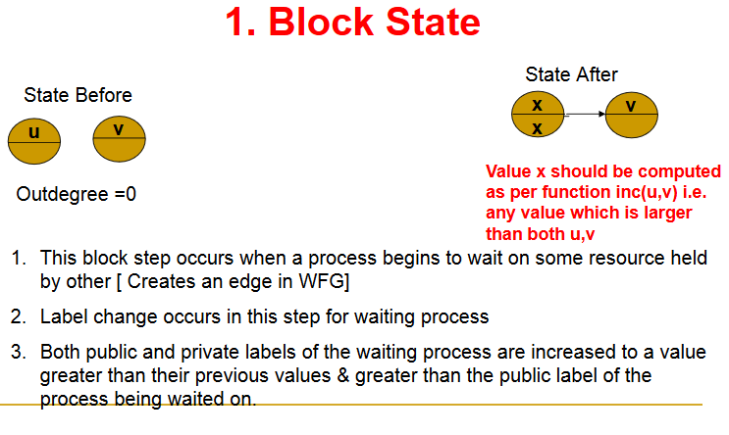

Slide 3
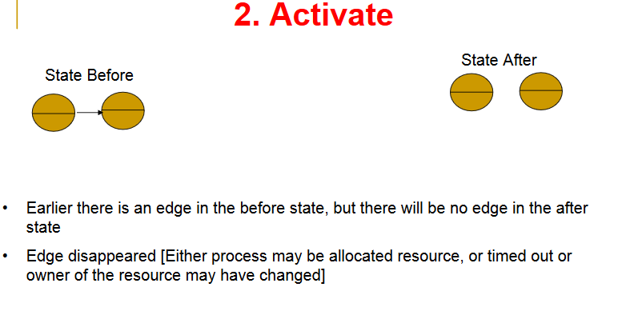

Slide 4
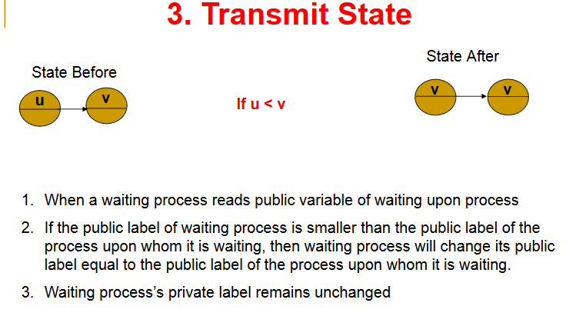
Notes:
This is different from block state because in the block state the edge is getting created and the value of the waiting process has public private label set to value grt than public of waited on process. Here the edge is already there but the value of the waited on process changes making u<v. In such a case the waiting process changes his public value to v.

Slide 5
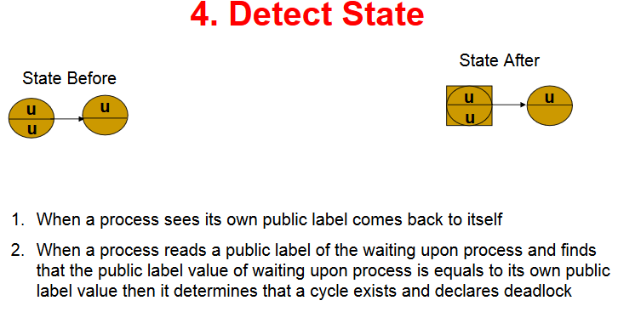

Slide 6
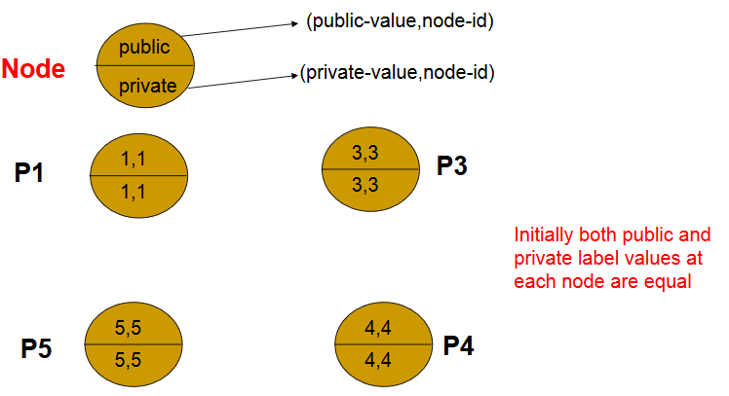

Slide 7
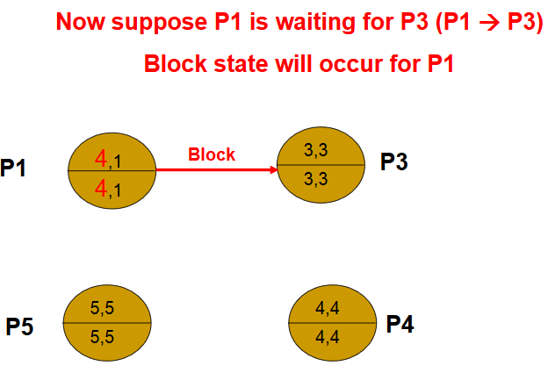

Slide 8
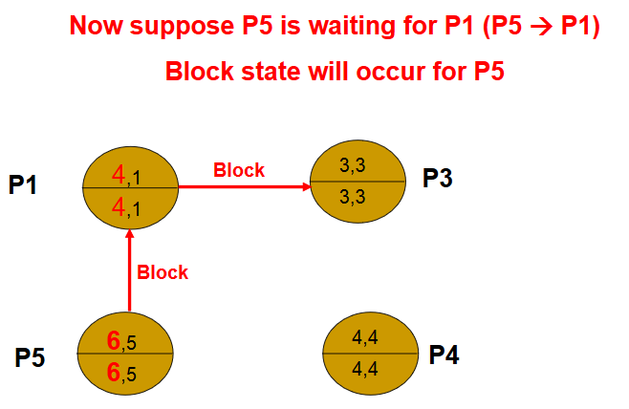

Slide 9
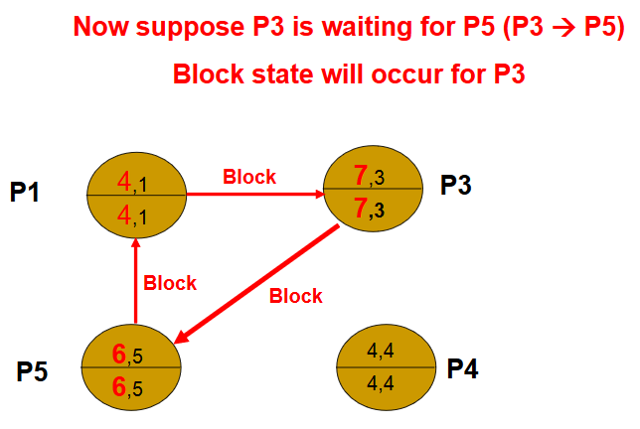

Slide 10
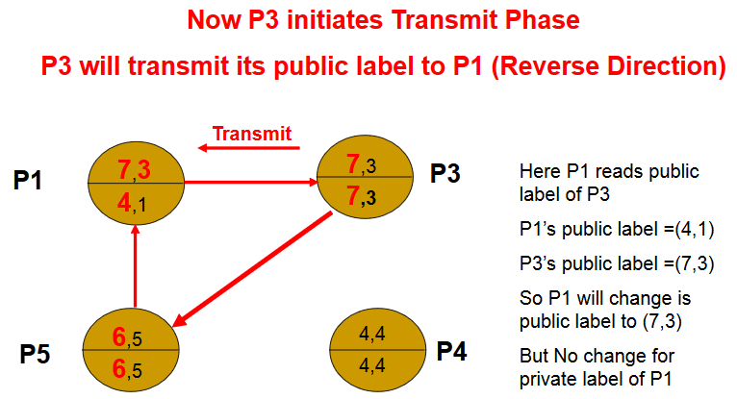

Slide 11
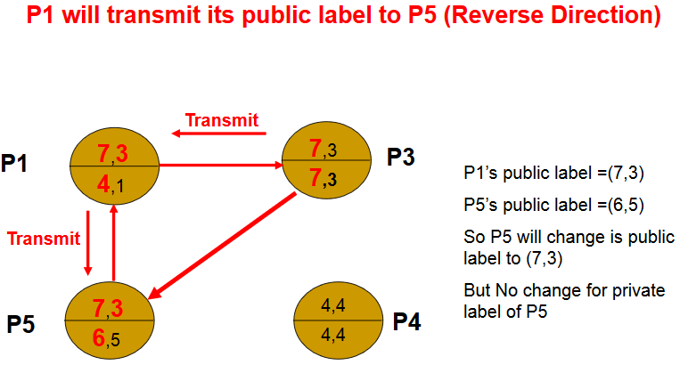

Slide 12
